Slide 1


SOCIAL BUZZ

Slide 2


Today's agenda
Project recap
Problem
The Analytics team
Process
Insights
Summary

Slide 3

Social Buzz is a fast growing technology that need
to adapt quickly to its global scale .
Accenture has begun 3 month project focusing on these tasks:
1. An audit of Social Buzz’s big data practice.
2. Recommendations for a successful IPO.
3. Analysis to find top 5 most popular categories of
content
Project Recap

Slide 4

Problem
Over 100,000 post per day
36,500,000 piece of content per year
How can we create content that resonates with our audience if we don't know what categories they love most?
Analysis to find top 5 most popular categories of content.

Slide 5



Andrew Fleming
Chief Technical Architect
The Analytics team
Marcus Rompton
Senior Principle
Ishwarya
Data Analyst

Slide 6
Process
1
Data Understanding
2
Data Cleaning
3
Data Modelling
4
Data Analysis
5
Uncovering Insights

Slide 7

Insights
UNIQUE CATEGORIES
CATEGORY WITH HIGH SCORE
Animals
MONTH WITH MOST POST
16
74K
MAY

Slide 8
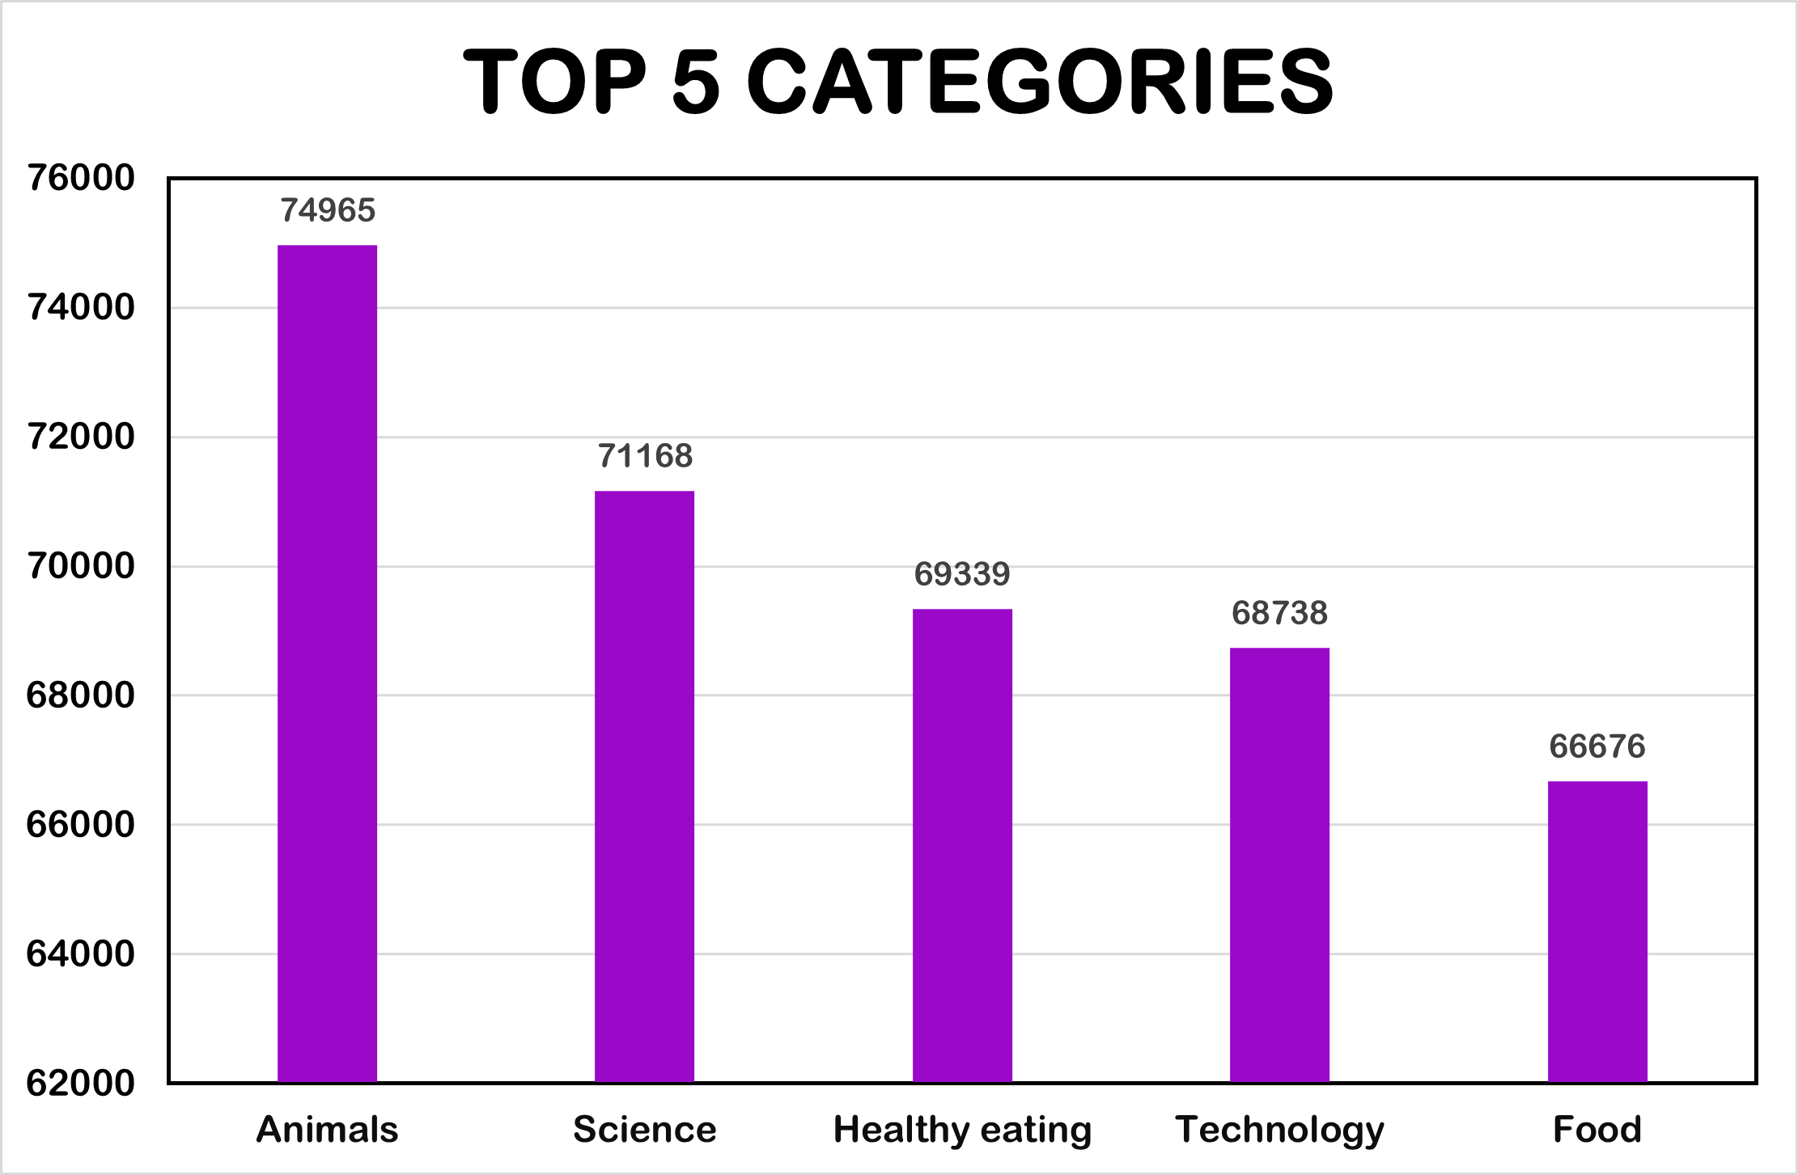

Slide 9
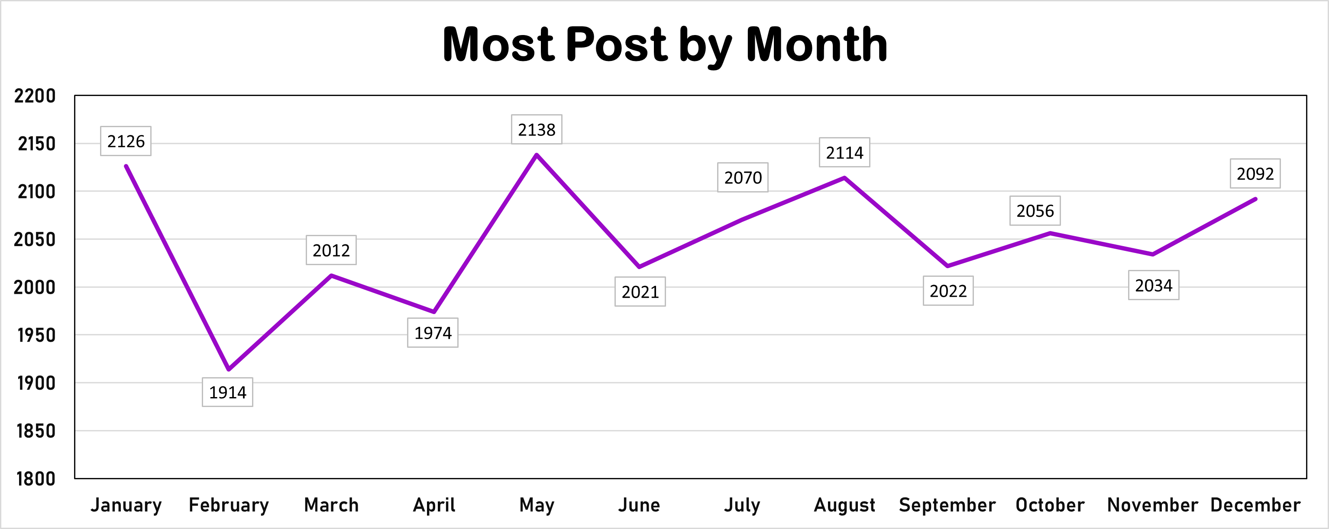

Slide 10
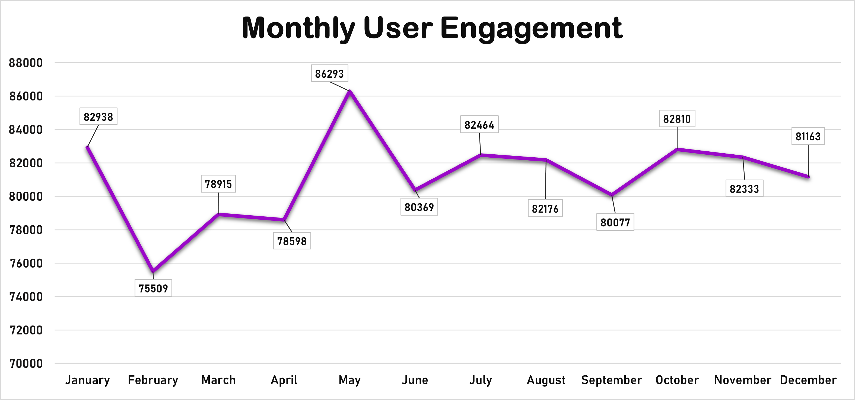

Slide 11

Analysis
Top 5 categories of content are Animals, Science, Health Care, Technology and Food.
May month recorded the highest number of post.
The month with highest user engagement is May.
Recommendation
Prioritize posting and promotions during May for maximum audience reach and engagement.
Create fun and interactive activities about animals, science, health, tech, and food to get people involved and excited.
Summary

Slide 12
Thank you!

